Slide 1

Who are you..?
Mouse Movement Measurement and Centralization

Slide 2
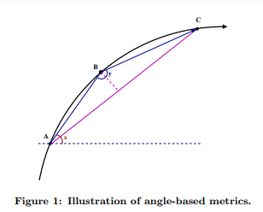
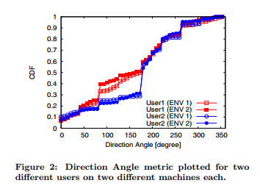
Mouse Movements Measurement
Data Collection
Data Processing
Data Metrics
Direction
Angle of Curvature
Curvature Distance

Slide 3
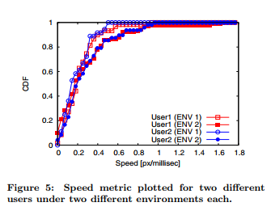
Mouse Movement Characterization
Dependence on Different Platforms
Uniqueness of Angle-Based Metrics Across Users
Distance Between Distributions

